Slide 1
ENVIRONMENTAL LAWS

Slide 2
The Water (Prevention & Control of Poll.) Act
This act was enacted by parliament in 1974 to prevent and abating water pollution. Under this act, the Central Pollution Control Board (CPCB) was constituted to promote cleanliness of streams and wells in different areas of the States. The CPCB was authorised to discharge the following functions:
Advise the Central Govt. on any matter pertaining to prevention and control of water pollution.
Co-ordinate the activities of the State Pollution Control Boards and resolve disputes among them.
Carry out and sponsor investigations and research relating to prevention/causes of water pollution.
Plan and organise training of persons to be engaged in programs for the prevention, control and abatement of water pollution
Organise comprehensive program through mass media regarding prevention and control of water pollution
Collect, compile and publish technical and statistical data relating to water pollution and the measures devised for its effective prevention and control
Prepare manuals, codes or guides relating to treatment and disposal of sewage and trade effluents.
Lay down, modify the standards for stream or well for the quality of water.

Slide 3
Under this act, the State Pollution Control Boards have the following function:
• To plan a comprehensive program for the prevention, control or abatement of pollution of streams and wells in the state
• To advise the State Govt. on the matter concerning the above.
• To collaborate with CPCB for training of personnel
• To inspect sewage or trade effluents, works and plants for the treatment of sewage or trade effluents
• To review plans, specifications or other data relating to setting up of sewage treatment plants, water treatment plants etc.
• To lay down standards for sewage and trade effluents and for the quality of waters form the discharge of effluents.
• To evolve economical and reliable methods of treatment of sewage and trade effluents
• To evolve methods of utilisation of sewage and suitable trade effluents in agriculture
• To evolve efficient methods of disposal of sewage and trade effluents on land.

Slide 4
Air (Prevention and Control of Pollution) Act
The Air (prevention and control of pollution) Act was enacted by the parliament in 1981 for the prevention, control and abatement of air pollution. It entrusts the power of enforcing this act to the Central as well as the State Pollution Control Boards.
Functions of the Central Pollution Control Board (CPCB)
The Central Pollution Control Board performs, the following functions.
1. Advise the central Govt. on matter concerning the improvement of the quality of air and the prevention, control or abatement of air pollution.
2. Plan the programme which is to be executed as a nationwide program for the prevention, control or abatement of air pollution.
3. Co-ordinate the activities of the state and resolve the disputes among them.
4. Provide technical assistance and guidance to the State Boards. Carry out and sponsor investigation and research relating to problems of air pollution.
5. Lay down the standards for the quality of air.
6. Collect, compile and publish technical and statistical data relating to air pollution and provide methods for its effective prevention, control or abatement - and prepare manuals, codes or guides relating to it.

Slide 5
Function of a State Pollution Control Board (SPCB)
The State Pollution Control Board performs the following functions.
1. To plan a comprehensive program for the prevention, control or abatement of air pollution.
2. To advise the State Govt. on any matter concerning it.
3. To inspect any control equipment, industrial plant or manufacturing process and to give, by order, directions to such persons as it may consider necessary for prevention, control or abatement of air
pollution.
4. To inspect air pollution, control areas for assessing the quality of air and take steps for prevention, control or abatement of air pollution.
5. To lay down, in consultation with the Central Board, standards of emission of air pollutants into the atmosphere from industrial plants and automobiles.
The Air (prevention control of pollution) Amendment Act was enacted in 1987 empowering the central and State Pollution Control Boards to meet with grave emergencies of air pollution.

Slide 6
The Environment Protection Act 1986
This was enacted by the parliament in 1986 to protect and improve the environmental quality, control and reduce pollution from all sources and prohibit or restrict the setting and/or operation of any industrial facility on environmental grounds. Power of the Central Govt. to take measures to protect and improve environment are mentioned as under:
• Coordination of actions by the State Govt.
• Planning and execution of nation wide program for prevention, control and abatement of environmental pollution.
• Laying down standards for emission or discharge of environmental pollutants from various sources.
• Restriction of area in which industries, operations or processes can not be carried out without adequate safeguards.
• Laying down procedures and safeguards for the prevention of accidents which may cause environmental pollution and provide remedial measures for such accidents.
• Laying down procedures and safeguards for handling of hazardous substances.
• Examination of such manufacturing processes, materials and substances that are likely to cause environmental pollution.

Slide 7
• inspection of any premises, plant equipment, machinery, manufacturing or other processes, material and substances and take necessary restrictive measures.
• establishment or recognition of environmental laboratories.
• preparation of manuals, codes or guides relating to the prevention, control and abatement of environmental pollution.
Some of the important aspect of this act are:
• persons carrying on industry, operation of process can not discharge any environmental pollutants in excess of prescribed standards.
• persons handling hazardous substances shall have to comply with the safeguards prescribed under the following rules:
(i) Hazardous wastes (management and Handling) Rules, 1986
(ii) Manufacture, storage and usage of Hazardous Chemicals Rules, 1989
(iii) Rules for manufacture, use, import, export, and storage of Hazardous Micro-organisms, genetically required organisms or cells.

Slide 8
Pollution Management Systems Initiatives taken by Government

Slide 9
National Clean Air Programme
As per the CPCB criteria, cities exceeding annual National Ambient Air Quality Standards (NAAQS) with respect to any one of the notified parameters for consecutively five years and with adequate number of ambient air quality monitoring stations (Minimum three stations in a city/town) are considered as Non-Attainment Cities (NAC’s). Based on the criteria, CPCB has identified 131 non-attainment cities exceeding NAAQS, which were notified to protect human health.
National Clean Air Programme (NCAP) has been launched by Ministry of Environment, Forest and Climate Change (MoEFCC) in January 2019 with an aim to improve air quality in 131 cities in 24 States by engaging all stakeholders.
NCAP envisages reduction in PM10 level up to 40% or achievement of national standards (60 µg/m³) by 2025-26.
City Action Plans (CAPs) have been prepared by all 131 cities and being implemented by Urban Local Bodies.
The city specific clean air action plans target city specific air polluting sources like Soil & Road Dust, Vehicles, Domestic Fuel, MSW Burning, Construction Material and Industries.
Notes:
https://pib.gov.in/PressReleasePage.aspx?PRID=1983680

Slide 10
Further, funding for implementation of CAPs is being mobilised through convergence of resources from various schemes of Central Government such as Swachh Bharat Mission SBM (Urban), Atal Mission for Rejuvenation and Urban Transformation (AMRUT), Smart City Mission, Sustainable Alternative towards Affordable Transportation (SATAT), Faster Adoption and Manufacturing of Hybrid and Electric Vehicles (FAME-II), Nagar Van Yojna, etc.
Public Grievance Redressal Portal (PGRP)/helpline have been developed by all 131 cities to address public complaints of air pollution in timely manner.
Emergency Response System (ERS/ GRAP) have been developed by all 131 cities for taking action in air emergencies.

Slide 11
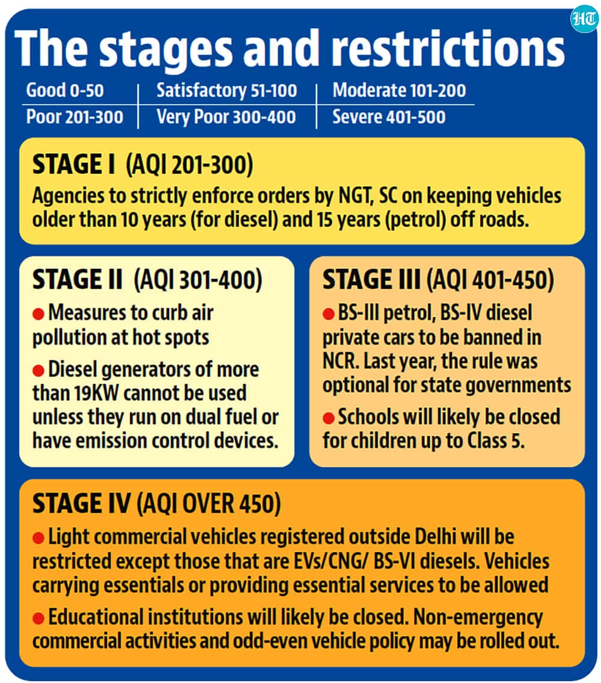
GRADED RESPONSE ACTION PLAN

Slide 12
Control of emissions from Stubble Burning
The Ministry of Agriculture and Farmers Welfare (MoA&FW) in 2018 launched scheme for providing subsidy for purchase of crop residue management machinery and establishment of custom hiring centres (CHCs) in NCT of Delhi and the States of Punjab, Haryana and Uttar Pradesh.
CPCB has framed guidelines for providing one time financial assistance for setting up of paddy straw based pelletization and Torrefaction plants which may help in addressing the supply chain issues and the issue of open burning of paddy straw in agriculture fields in Northern Region.
CPCB has made the guidelines under which one-time financial assistance is provided to Municipal Corporations, Municipal Councils and Zilla Parishads of the states of Punjab, Haryana, NCT of Delhi and NCR districts of Uttar Pradesh and Rajasthan, for establishing paddy straw based briquetting plants for use of briquettes for cremation purpose only.

Slide 13
National Water Quality Monitoring Programme
The Central Pollution Control Board (CPCB) in association with State Pollution Control Boards (SPCBs) / Pollution Control Committees(PPCs) is monitoring the quality of water bodies at 2500 locations across the country under National Water Quality Monitoring Programme (NWQMP) which indicate that organic pollution is the predominant cause of water pollution.
https://www.pib.gov.in/newsite/PrintRelease.aspx?relid=137979#:~:text=Implementation%20of%20National%20Lake%20Conservation,Aquatic%20Eco%2Dsystems%20(NPCA)

Slide 14
The steps taken by the Government to address the issues of water pollution include the following:
Preparation of action plan for sewage management and restoration of water quality in aquatic resources by State Governments.
Installation of Online Effluent Monitoring System to check the discharge of effluent directly into the rivers and water bodies.
Action to comply with effluent standards is taken by SPCBs to improve the water quality of the rivers.
Financial assistance for installation of Common Effluent Treatment Plants for cluster of Small Scale Industrial units;
Issuance of directions for implementation of Zero Liquid Discharge.

